Slide 1



Slide 2

Agenda
Overview
Diagram
Components
Endpoint
Matrix and Validation
Notifications

Slide 3
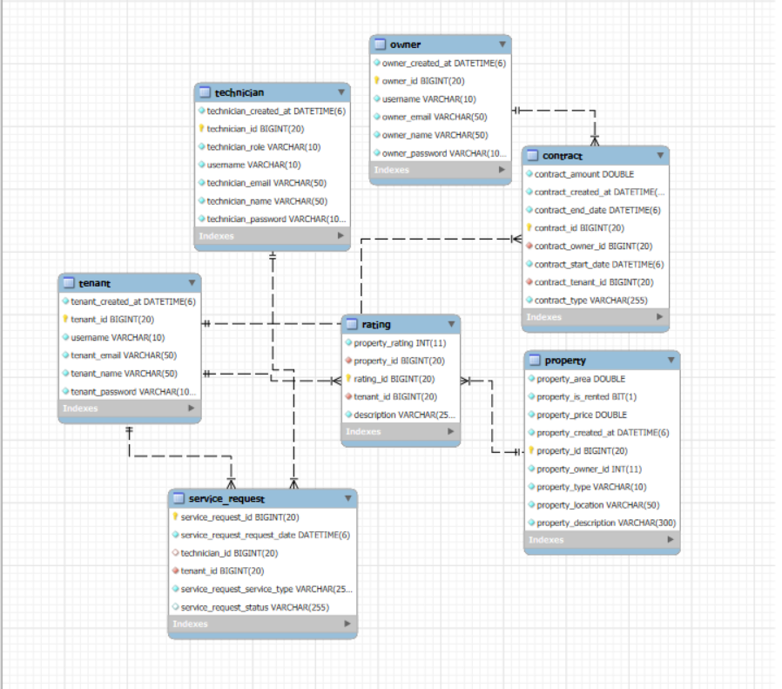
Diagram

Slide 4

Components
Owner property
Tenant
Technician
Contact
Requests
Rating

Slide 5
Endpoint
Owner property
Check all contacts status
Assign contracts , Check request Properties
Send notification to tenant
Tenant
Send request to get Property
Request service
Check contract details
Technician
Add rating property
Get all ratings for a specific property
Get the top-rated , bad rated properties
Rating
Find request same role
Assign request same role
Complete request
Contract
Endpoint find all active contracts
Endpoint to find all contract's amount in range
Endpoint to find all contract’s Dates in range

Slide 6

Matrix and Validation
Owner property
only can add contract
only can add property
Tenant
can request service
Can Request Property
Technician
assign Request
complete Request

Slide 7

Notifications
Owner property
receive email add, update
Send Email new contract
Tenant
Send Email new Request Property
receive email to add, update
receive email request service
receive email assign has Request
receive Email new contract
Technician
receive email to add, update
receive email assign Request

Slide 8

Thank You
Hussam Alsaedi

